Slide 1
Model View Template (MVT)
The MVT is an design pattern that separates an application into three main logical components Model, View, and Template.
Each of these component has their own role in a Project.

Slide 2
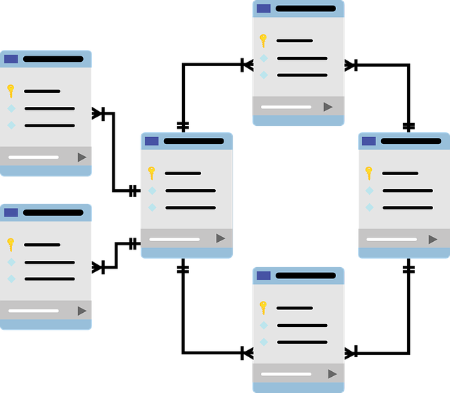
Model
The Model responsible to handle database. It is a data access layer which handles the data.

Slide 3

View
The user can send request by interacting with template, the view handles these requests and sends to Model then get appropriate response from the Model, sends response to template.
It may also have required logics.
It works as a mediator between Template and Model.

Slide 4
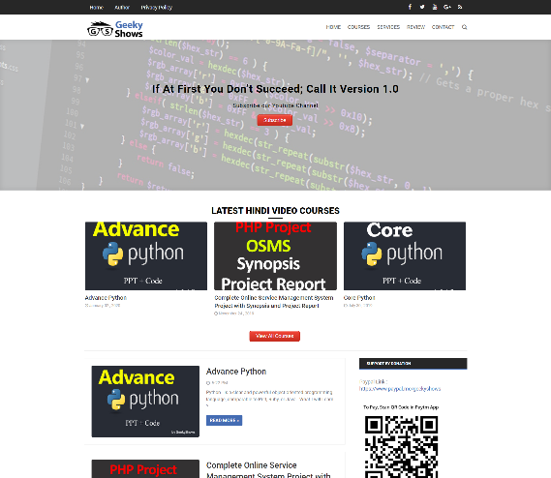
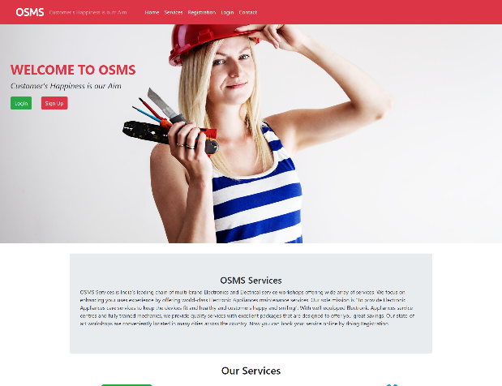
Template
It represents how data should be presented to the application user. User can read or write the data from template.
Basically it is responsible for showing end user content, we can say it is user interface.
It may consists of HTML, CSS, JS mixed with Django Template Language.

Slide 5
Server Side Logic
Process GET/POST
Get data from User
Gets data from Model
Pass data to Template
View
Insert/Update DB
Communicate with View
Model
Routing
Template
Database
User Interface
HTML/CSS
Get Data from View

Slide 6
Server Side Logic
Process GET/POST
Get data from User
Gets data from Model
Pass data to Template
View
Urls
Process Data
Insert/Update DB
Communicate with View
Model
Template
Database
User Interface
HTML/CSS
Get Data from View

Slide 7
Why use MVT
Organized Code
Independent Block
Reduces the complexity of web applications
Easy to Maintain
Easy to modify

Slide 8
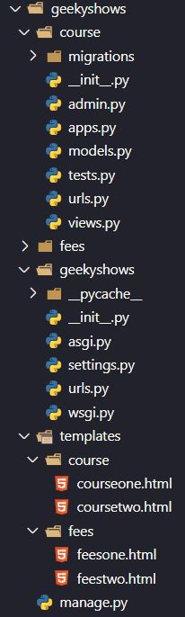
Basic Structure

